Slide 1
Category review: Chips
June 2020
Retail Analytics
Brand note: If client logo is not required, use alternate title page layout right click slide thumbnail > Layout > Title

Slide 2
Notes:
To view Privacy video explaining how important data privacy is to Quantium, please click here: https://www.youtube.com/watch?v=Zq1QDAkoRzU
or here Q:\Company Reference\Brand & Design\Brand videos\Q Privacy.mp4
At Quantium, we believe that data is the behavioural footprint of humanity and that it has to be treated with the utmost care and responsibility.
Histories, attitudes, indeed lives are stored within it in ways that aren’t always apparent – and that’s what makes its potential so powerful.
To work with it responsibly, sensitively, we set ourselves the highest data privacy protection and governance standards.
We have spent 17 years perfecting privacy-by-design and secure-by-design principles. Central to this is not holding any personally identifiable information about people –
we neither receive it, and put the necessary protections in place to be unable to decipher it.
Every aspect of handling data is safeguarded: from its de-identification, to its encryption – data security is paramount and of the highest grade.
We pride ourselves on gaining the trust of iconic organisations around the world through years of securely working with their data,
and in turn the trust that builds with their stakeholders.

Slide 3
Executive summary
01
Task 1
- Mainstream young singles/couples are the largest customer segment in terms of total sales.
- Mainstream, young singles/couples are also the largest customer segment in terms of population.
- Budget - older families have the highest average price per packet of chips and spend more on chips than their premium counterparts.
- Mainstream - young singles/couples have the highest average number of chips bought per customer.
- Mainstream - retirees have the lowest average number of chips bought per customer and also spend the least on chips.
- Chips with a price point of 2.6 dollars have the highest sales across all customer segments.
02
Task 2
- After analyzing the data, we found that trial stores 77 and 86 had sales for February, March, and April that exceeded the 95% threshold of their respective control stores (store 233 for trial store 77 and store 155 for trial store 86).
- However, trial store 88 did not show a significant increase in total sales or number of customers during the trial period compared to its control store (store 40). It is possible that there were factors specific to trial store 88 that affected its performance during the trial period.
- Overall, the trial showed a positive and significant result, with trial stores 77 and 86 performing well during the trial period. These findings suggest that the trial was effective in increasing sales and attracting more customers to the trial stores.

Slide 4
01
Category

Slide 5
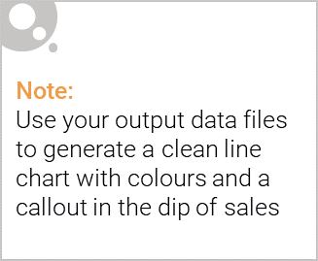
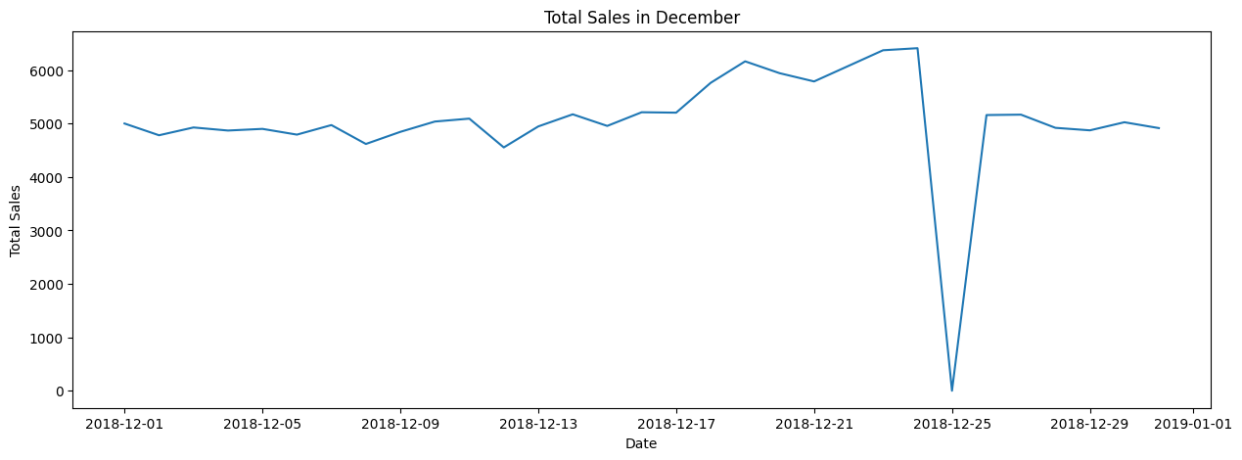
The day with no transaction is a Christmas day that is when the store is closed hence there is a dip in sales on 25th December as shops were nonoperational.
Sales increase steadily as the Christmas day approaches and return again to early December sales level during New Year Eve.

Slide 6

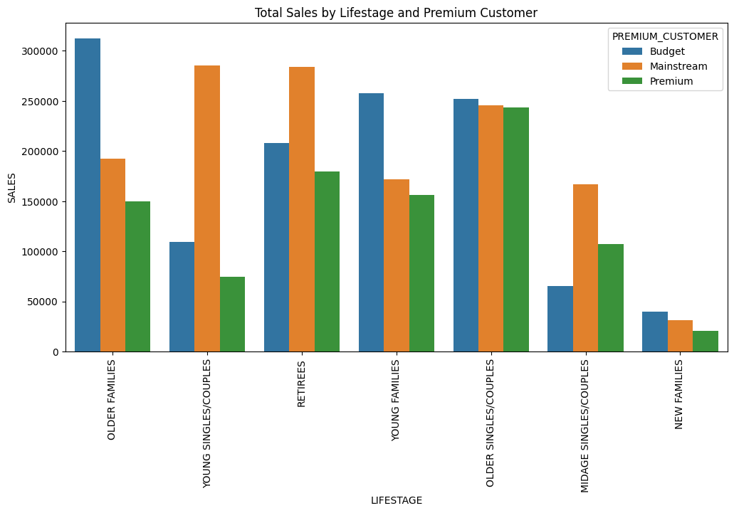
Sales mainly came from Budget - older families, Mainstream – young singles/couples, and Mainstream - retirees. In total contributing 25% of sales revenue.
• Older and Young Family segment have the highest average purchase units per unique customer

Slide 7
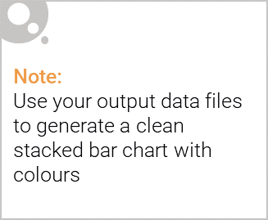
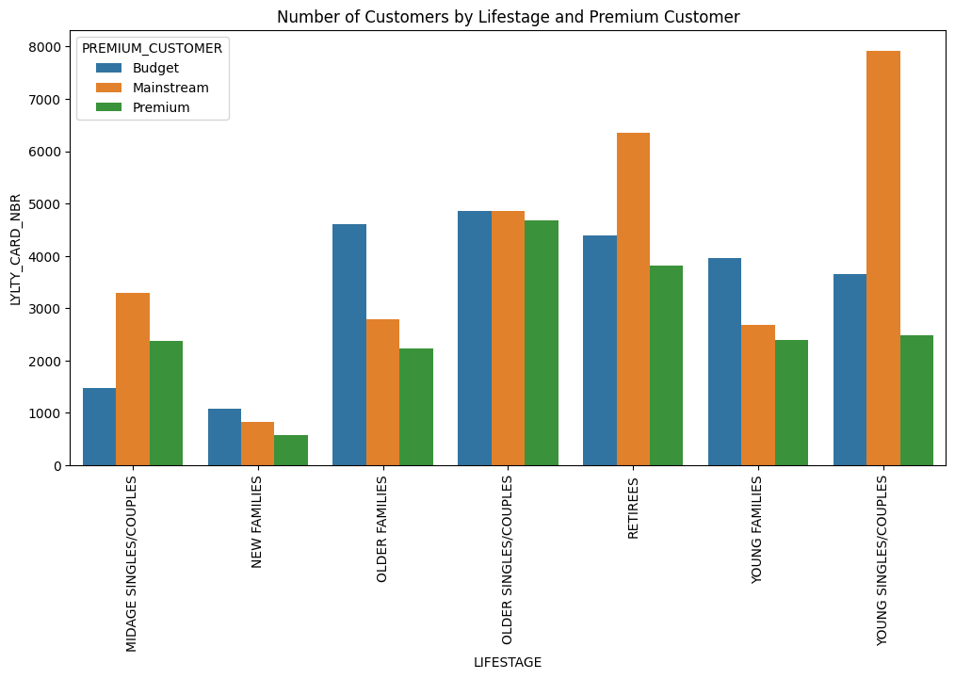
Editable (delete this)
Based on our analysis of customer data, we found that the highest proportion of mainstream customers is among retirees, young singles, and young couples. These customer segments have the largest share of customers who fall into the mainstream category based on their affluence and life stage.

Slide 8
02
Trial store performance

Slide 9
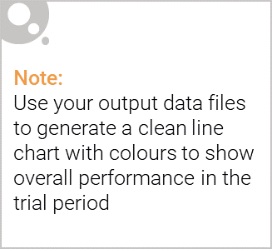
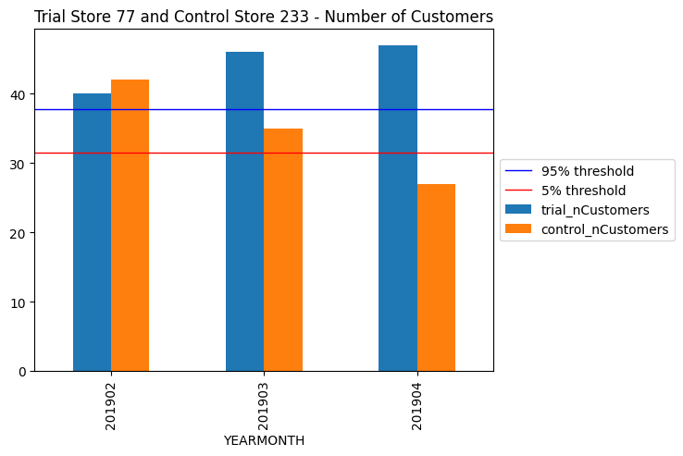
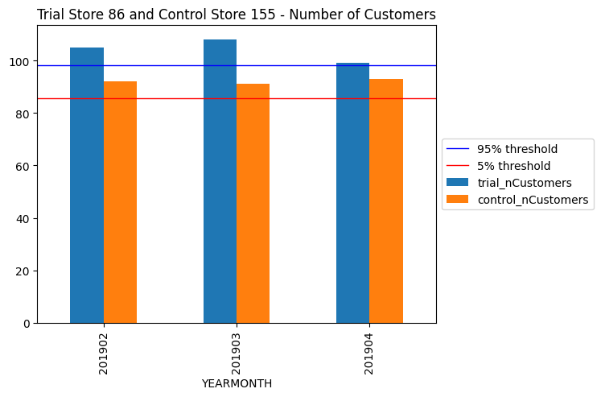
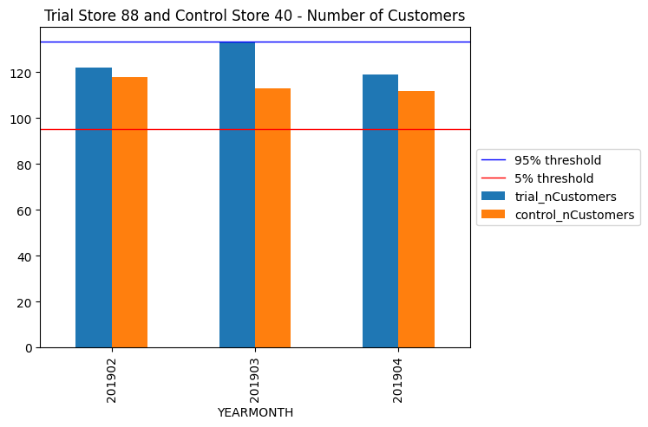
We can see that Trial store 77 sales for Feb, March, and April exceeds 95% threshold of control store. Same goes to store 86 sales for all 3 trial months.
Whereas trial store 88 sales increase is insignificant

Slide 10
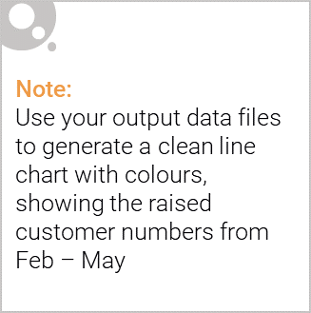
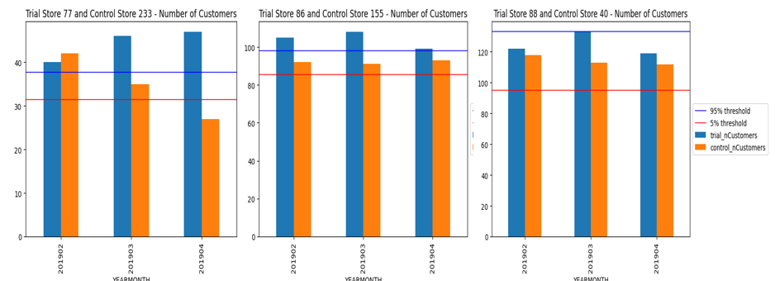
1. Trial store 77: Control store 233
2. Trial store 86: Control store 155
3. Trial store 88: Control store 40
4. Both trial store 77 and 86 showed significant increase in Total Sales and Number of Customers during trial period. But not for trial store 88. Perhaps the client knows if there's anything about trial 88 that differs it from the other two trial.
5. Overall the trial showed positive significant result.

